Slide 1



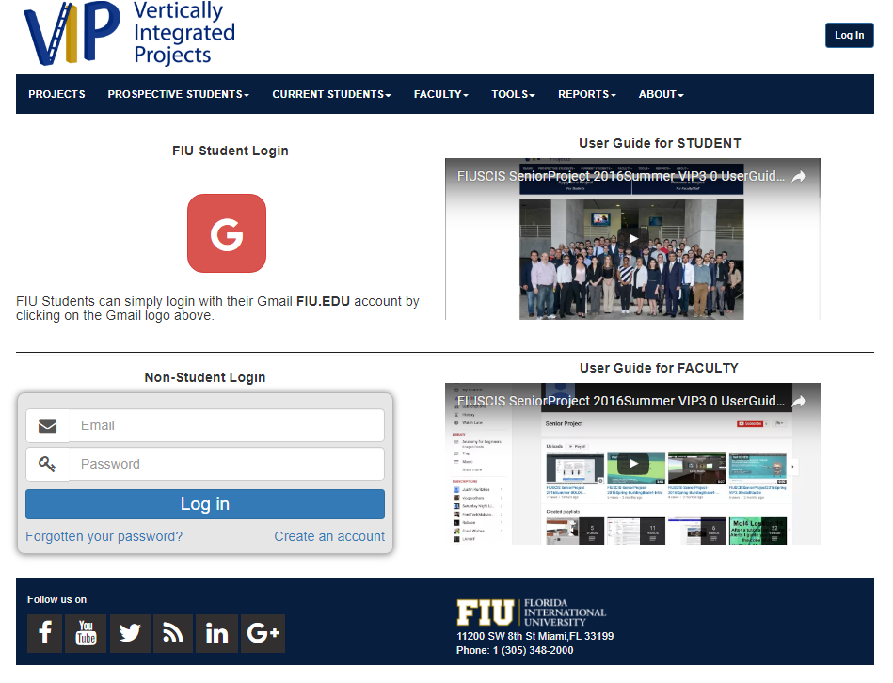
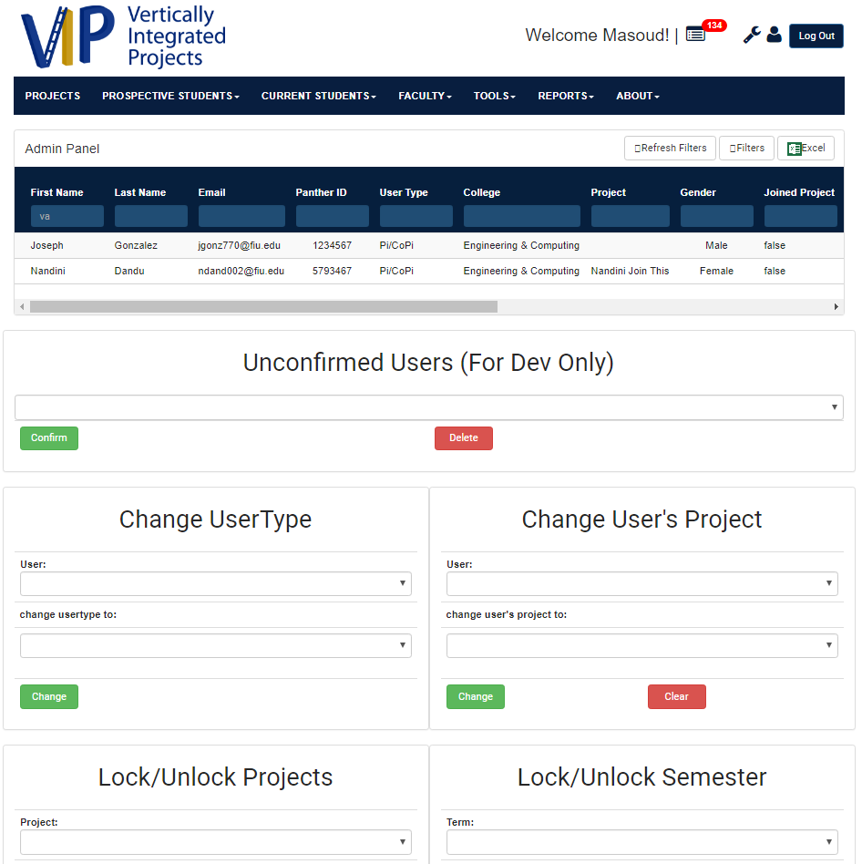
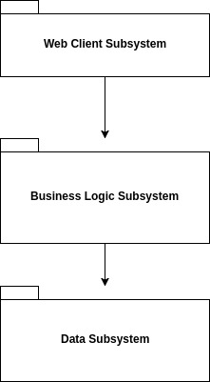
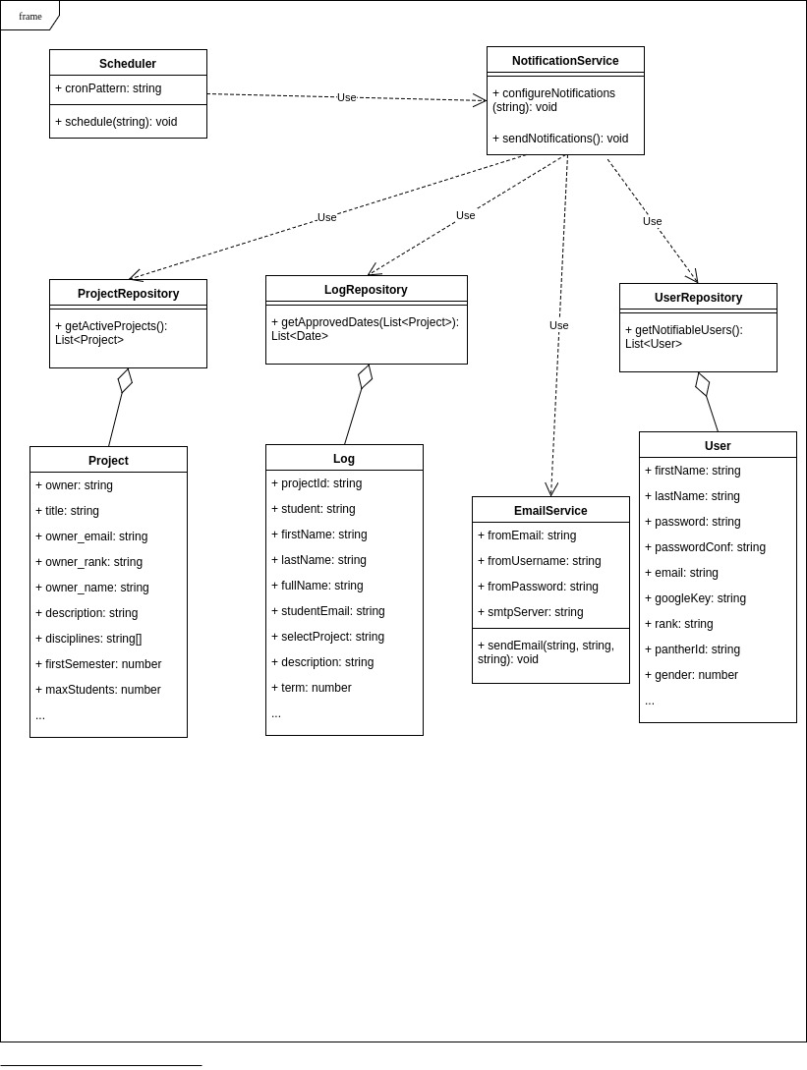
School of Computing & Information Sciences
CIS 4911 Senior Project, 2017, Summer
VIP: Vertically Integrated Projects
Student: Jose C. Ponce , Florida International University
Mentor: None
Instructor: Masoud Sadjadi, Florida International University
Problem
Research and Development
Faculty Lead
Student Teams
Product Design to Deployment
Solution
Web Based Interface
Project Management
Administrator Supervised
Easy to Use
Student/Faculty Users
Current System
Minimal Functionality
Administrator Centered
Vulnerable to Attacks
Manual Deployment
Requirements
Secure System
More Stable
Improved Performance
Simple User Interface
Cosmetic Improvements
System Design
Traditional 3-tier system architecture
Implementation
AngularJS Web Front-end
Express/NodeJS backend
Restful web API
PassportJS authentication
Ubuntu backend host
Cron job scheduler
MongoDB NoSQL DBMS
Mongoose MongoDB Client
Verification
Automated test environment deployment with Teamcity-Docker-Kubernetes
Automated Selenium tests
Final testing done in static server via manual deployment of the application.
Object Design
Summary
Main Problem: Project and User management
Administrator oversees the state of the System
Web Based
Implemented fully in Javascript
Simple design and User interface.
Acknowledgement
The material presented in this poster is based upon the work supported by the VIP project team. I am thankful to the help that I received from my teammate Dafna Steinberg, and our project owners Masoud Sadjadi and Francisco Ortega.
Notes:
1

